Slide 1
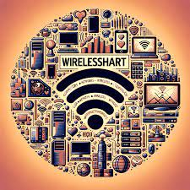
Wireless HART: A Wireless Protocol for Industrial Automation
PRESENTED BY :
MOSHIUR RAHMAN
ID: IT21049
SUPERVISED BY:
Dr. Nazrul Islam
Associate professor
DEPT. OF ICT, MBSTU

Slide 2
INTRODUCTION
WirelessHART (Wireless Highway Addressable Remote Transducer) is an open-standard wireless communication protocol designed specifically for industrial process automation and monitoring.Developed by the HART Communication Foundation in 2007, it is an extension of the wired HART protocol, maintaining backward compatibility while introducing wireless flexibility.
WirelessHART enables secure, reliable, and real-time data exchange between field instruments, controllers, and control systems without the need for physical wiring — significantly reducing installation and maintenance costs.

Slide 3
Technical Overview
Communication Standard: IEEE 802.15.4 (2.4 GHz ISM Band)
Network Type: Self-organizing mesh topology
Data Rate: 250 kbps
Channel Hopping: Frequency-hopping spread spectrum (FHSS) to avoid interference
Network Synchronization: Time Division Multiple Access (TDMA) for efficient scheduling
Security: 128-bit AES encryption, device authentication, and integrity checks

Slide 4
Main Components(...)
Field Devices
Include sensors, actuators, and transmitters equipped with WirelessHART communication.
Collect and transmit real-time data such as temperature, pressure, or flow rate.
Gateway
Serves as a bridge between the WirelessHART network and the plant’s control system (DCS/PLC/SCADA).
Translates wireless data into standard industrial communication protocols.

Slide 5
Main Components(...)
Network Manager
Controls the formation and maintenance of the wireless mesh network.
Assigns communication paths, manages bandwidth, and ensures data reliability.
Security Manager
Maintains encryption keys, ensures authentication, and manages secure data transfer.

Slide 6
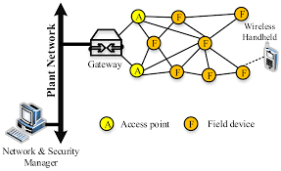
Working Principle
WirelessHART uses a mesh networking approach where each device can communicate with its neighbors.
If one path fails, the data automatically reroutes through another device, ensuring continuous connectivity.
The Network Manager schedules communication using TDMA slots, reducing collisions and improving energy efficiency.

Slide 7
Applications
Oil & Gas: Pipeline monitoring, leak detection, and asset tracking
Chemical Industry: Process parameter monitoring (temperature, pressure, pH)
Power Plants: Equipment health monitoring and predictive maintenance
Water & Wastewater: Flow and level measurement in remote locations
Manufacturing: Machine condition monitoring and energy optimization

Slide 8
Advantages
Reduced Installation Cost: Eliminates the need for long and expensive wiring
High Reliability: Mesh topology ensures multiple communication paths
Enhanced Security: 128-bit AES encryption and device authentication
Low Power Consumption: Suitable for battery-operated field devices
Scalability: Supports addition of new devices without major reconfiguration
Real-time Monitoring: Enables continuous data collection and system visibility

Slide 9
Limitations
Future Scope
Limited data bandwidth for high-speed applications
Possible signal interference in dense industrial environments
Shorter communication range in metal-rich or obstructed areas
Integration with Industrial Internet of Things (IIoT) and 5G networks
Use of AI and machine learning for predictive maintenance
Development of energy-harvesting devices for long-term operation
Enhanced interoperability with other wireless standards

Slide 10
Thank you!

